Slide 1
EDUCATIONAL DATA MINING FOR STUDENTS PERFORMANCE
NAME: SARANYA S
DATE OF SUBMISSION: 18.10.2024

Slide 2
Educational Data Mining (EDM)
Educational Data Mining (EDM) is the process of using data mining techniques to analyze educational data and extract meaningful insights that can improve teaching and learning outcomes. EDM involves exploring large datasets from educational systems, such as student demographics, academic records, and online learning behaviors, to discover patterns and trends that can help educators make informed decisions.

Slide 3
Why Student Performance Analysis is Important:
Identify At-Risk Students: EDM helps predict which students are likely to struggle or drop out, allowing early intervention and personalized support.
Improve Learning Outcomes: By understanding factors that affect performance, educators can tailor teaching methods to meet individual needs, leading to better learning outcomes.
Optimize Resources: Schools and universities can allocate resources more effectively by focusing on areas where students need the most support.
Enhance Personalization: EDM enables personalized learning experiences by adapting content and pacing to suit individual student preferences and abilities.
Data-Driven Decision Making: It provides educators and administrators with data-backed insights to improve curriculum design, assessment methods, and overall educational strategies.

Slide 4
Key Objectives:
Predict Student Performance
Use data to predict whether students will pass or fail.
Identify Key Factors
Determine the factors that most influence student success.
Early Warning System
Flag students at risk of underperforming for timely intervention.
Provide Data-Driven Insights
Help educators make informed decisions to improve learning outcomes.

Slide 5
Data Overview:
Dataset Description:
Number of records, features (e.g., gender, test scores, parental education).
Data source: (e.g., UCI dataset, or a school-specific dataset if applicable).
Key variables: e.g., math score, reading score, writing score, demographic information.
Include a Dataset which I am used in this project. In next slide I insert the screenshot of the dataset.

Slide 6
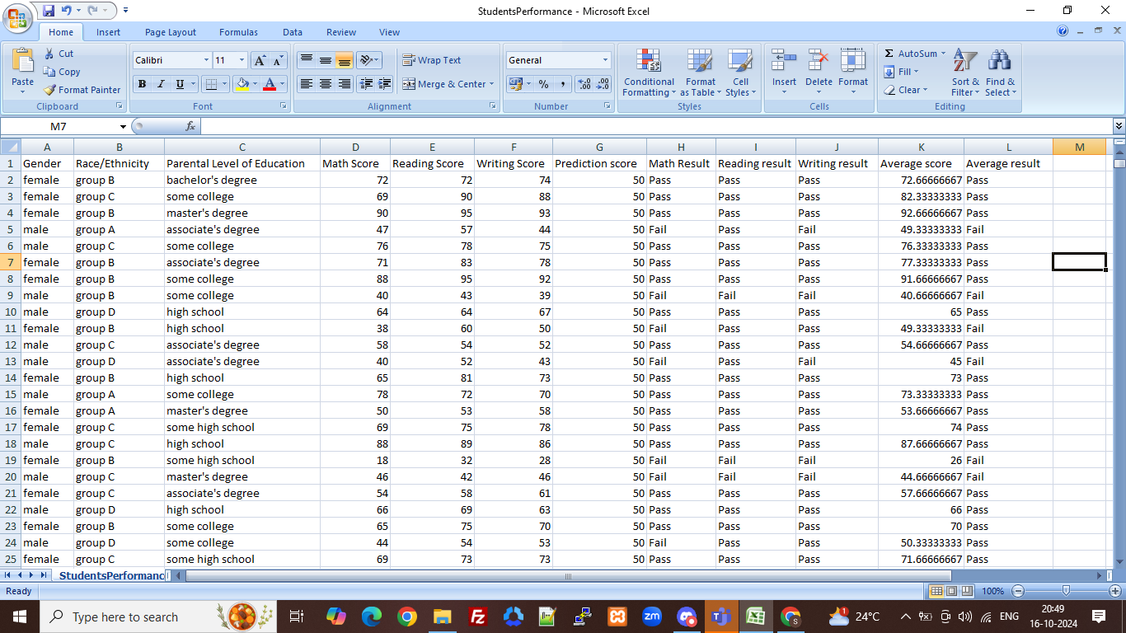

Slide 7
Data Preprocessing:
Steps taken to clean and preprocess the data:
Handling missing values.
Label encoding for categorical variables.
Creation of the target variable (pass/fail based on average score).
# Create a target variable (pass/fail based on average score)
df['average_score'] = df[['math score', 'reading score', 'writing score']].mean(axis=1)
df['pass_fail'] = np.where(df['average_score'] >= 50, 1, 0) # 1 = Pass, 0 = Fail
# One-hot encode categorical variables
df_encoded = pd.get_dummies(df, columns=['gender', 'race/ethnicity', 'lunch', 'test preparation course'], drop_first=True)
# Drop unnecessary columns
df_encoded.drop(columns=['math score', 'reading score', 'writing score', 'average_score'], inplace=True)

Slide 8
Data Visualization
POWER BI:
Title: Keep a clear and descriptive title for each visualization.
Example: "Average Student Performance in Math, Reading, and Writing by Gender".
Explanation:
This chart shows the average performance across the three subjects (Math, Reading, Writing) based on a fixed prediction score of 50. The results are displayed by gender, indicating whether students passed or failed. A score of 50 or higher is considered a 'Pass,' while a score below 50 is considered a 'Fail.'

Slide 9
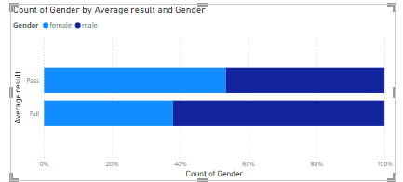
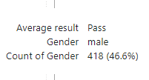




Slide 10
Model Selection:
Machine Learning Models Used:
Decision Tree Classifier (or other models tried: Random Forest, SVM, etc.). Why this tree was chosen?
Simplicity:
Decision Trees are straightforward and easy to implement. They don't require extensive data preprocessing or scaling, making them ideal for educational datasets with mixed data types (numerical and categorical).
Interpretability:
One of the biggest advantages of Decision Trees is their interpretability. Educators and administrators can easily understand the decisions the model makes, as the tree structure clearly shows how each factor (e.g., parental education, test preparation) contributes to predicting student performance.

Slide 11
3) Accuracy:
Decision Trees provide competitive accuracy, especially when the relationships in the data are well-defined, as is the case with educational performance (e.g., test scores are naturally correlated with success). Additionally, Decision Trees can handle both classification and regression tasks effectively.
Evaluation Metrics:
Accuracy, precision, recall, F1-score.

Slide 12
Python Script in Power BI:
You can write Python code directly within Power BI to manipulate the data, create visualizations, or train a machine learning model.
Here’s an example Python script that calculates average scores and adds a pass/fail column:
Example Python Script in Power BI:
python
import pandas as pd
# 'dataset' is the data frame loaded by Power BI
# Calculate the average score and create a pass/fail column dataset['average_score'] = dataset[['math score', 'reading score', 'writing score']].mean(axis=1)
dataset['pass_fail'] = dataset['average_score'].apply(lambda x: 'Pass' if x >= 50 else 'Fail')

Slide 13
Improving Student Performance: Key Strategies
Identify Key Factors
Analyze data to find what impacts performance most (e.g., attendance, test preparation).
Early Warning System
Flag at-risk students for timely intervention.
Personalized Learning
Tailor learning plans based on individual student needs.
Enhance Test Preparation
Provide extra support for students lacking preparation.
Boost Engagement
Encourage participation and track attendance for better outcomes.
Parental Involvement
Foster communication between teachers and parents to support students.
Optimize Resources
Allocate resources to areas where students struggle the most

Slide 14
THANK YOU

